Slide 1

IPL Data Analysis Using Streamlit
Presentation by Sourav Chatterjee

Slide 2

Contents
Introduction
Data Flow Diagram
Data Description
Functionality of web application
Modules and libraries used
Conclusion

Slide 3
Introduction
Project Overview
Purpose
Introduction to Streamlit
The IPL Data Analysis project aims to create an interactive web application for exploring and analyzing IPL data. By leveraging Streamlit, users can visualize various statistics and insights from IPL matches.
The primary objective of this project is to provide cricket enthusiasts, analysts, and fans with a dynamic platform to interact with IPL data in a user-friendly manner. Streamlit enables real-time adjustments and enhances user engagement.
Streamlit is an open-source Python library that simplifies the creation of web applications for machine learning and data science projects. It allows for rapid prototyping and deployment of data-driven apps.

Slide 4
Data Flow Diagram
IPL Dataset
(from kaggle)
Data Ingestion
(pandas)
Data Processing
(Cleaning and transformation)
User Interaction
(Streamlit widgets)
Visualization
(Streamlit,plotly)

Slide 5

Data Description
Datasets Overview
Data Sources and Features
The project utilizes datasets related to IPL matches, players, and teams to extract valuable insights. These datasets are vital for conducting in-depth analysis and generating meaningful visualizations. The datasets are collected from - https://Kaggle.com
The IPL data sources include official match records, player statistics, and team performance metrics. Key features and columns encompass match results, player scores, team standings, and more.

Slide 6
Web Application Functionalities
Interactive Charts and Graphs
Filtering Options
User Input Widgets
The web application offers interactive visualizations such as line charts, bar graphs, and pie charts to present IPL data trends effectively.
Users can filter data based on specific criteria like team vs team analysis, players analysis(batsman & bowler), season wise analysis, and performance indicators, enhancing the data exploration experience.
Features like dropdown menus, sliders, and etc that empower users to customize and focus their data analysis, providing a personalized interaction with the IPL data.

Slide 7
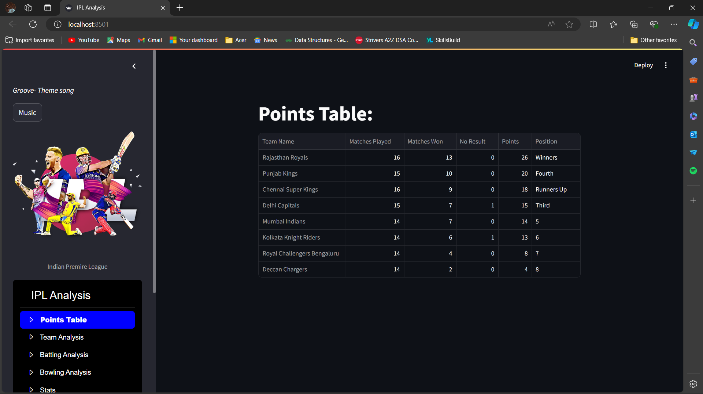
Quick look into the interface

Slide 8
Modules and Tools Used
Python Libraries
Streamlit Framework
Additional Tools ( that can further be implemented)
The main Python libraries utilized in the project include Numpy for numerical computations, Pandas for data manipulation, and Plotly (Plotly Express) for creating interactive visualizations.
Streamlit serves as the primary framework for developing the web application, enabling seamless integration of data analysis components and facilitating user-friendly interactions with IPL data.
Supplementary tools like Matplotlib for data plotting and Scikit-Learn for machine learning models may also be incorporated to enhance the project's analytical capabilities.

Slide 9
Conclusion and Future Work
Summary
In conclusion, the IPL Data Analysis project using Streamlit offers a compelling platform for exploring IPL data insights in an interactive manner. The project successfully combines data visualization with user engagement to deliver a rich analytical experience.
Future Enhancements
Potential future enhancements may involve incorporating machine learning algorithms for predictive analysis, integrating live data feeds during IPL matches, and expanding the web application's features to include social sharing options for users.

